Slide 1

WasteWise: AI-Powered Waste Management
Transforming recycling through intelligent automation and real-time data insights

Slide 2

THE CHALLENGE
A Broken Recycling System
The Problem
Contamination Crisis
Traditional recycling systems are failing our cities
One wrong item spoils entire batches of recyclables
Manual Inefficiency
Hand-sorting increases costs, time, and error rates
Resource Waste
Low recycling rates mean valuable materials end up in landfills

Slide 3

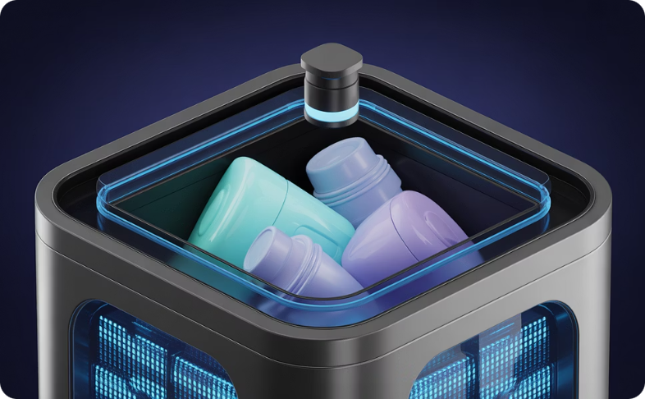
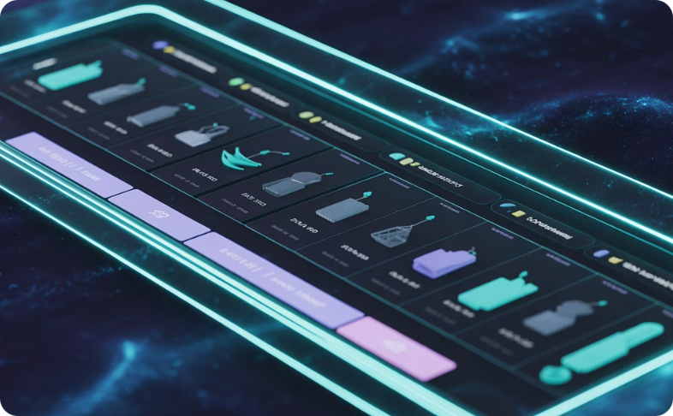

THE SOLUTION
WasteWise: Intelligent Sorting at the Source
AI-Powered Classification
Eliminates Human Error
Source Separation
Automatically identifies and categorizes waste materials with precision
Smart automation ensures accurate disposal every time
Correct classification happens before contamination occurs

Slide 4
WasteWise: Smart Waste Management
Waste Categorization
AI Classification
Recyclable, compostable, hazardous, non-recyclable
LLM, rules, knowledge graph
FastAPI Backend
Database Storage
Python backend processes data
User data, bin status, analytics
Implement WasteWise System
Data Collection
Route Optimization
QR scan, camera capture, sensors
Capacity analysis, GPS tracking
Inefficient Waste Management
Efficient Waste Management
Smart Bin Deployment
Overflowing bins, unoptimized routes
Optimized routes, reduced waste
Residents dispose waste into bins

Slide 5

Real-Time Smart Bin Monitoring
Proactive Waste Control
Live Fill Monitoring
Track bin capacity in real-time across your entire network
Capacity Analytics
Instant alerts when bins reach critical levels
GPS Location Tracking
View exact bin positions on an interactive map
Overflow Prevention
Stop contamination before it starts with predictive alerts

Slide 6





Data-Driven Route Optimization
AI Analysis
Data Collection
Route Optimization
Efficient Collection
Advanced analytics transform waste management from reactive to strategic
Optimized Routes
Cost Reduction
Waste Prediction
User Accountability
AI calculates most efficient collection paths
Lower fuel usage and labor expenses
Forecasts generation patterns per location
Personal waste profiles drive behavior change

Slide 7




Credit System: Incentivizing Change
Sort Correctly
Proper disposal earns digital credits
Accumulate Points
Credits tracked in personal account
Redeem Rewards
Cash, discounts, or shopping credits
Positive reinforcement drives lasting behavioral change in recycling habits

Slide 8

IMPACT
Why WasteWise Transforms Cities
45%
30%
60%
Recycling Rate Increase
Cost Reduction
Landfill Diversion
Measured improvement in first-year pilots
Lower operational and labor expenses
More recyclables properly processed
From Reactive to Proactive
Environmental Benefits
Real-time actionable insights
Predictive capacity management
Data-driven policy decisions
Reduced carbon footprint
Cleaner public spaces
Resource conservation at scale

Slide 9
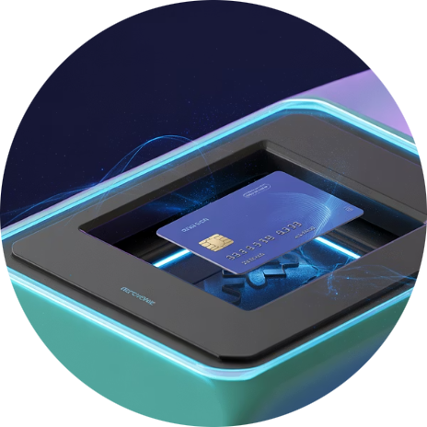

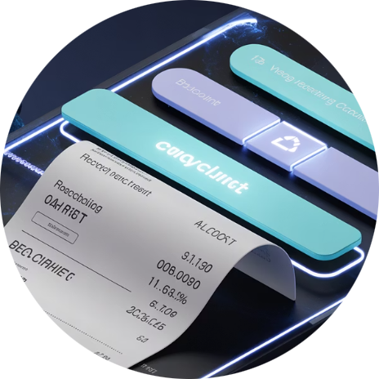
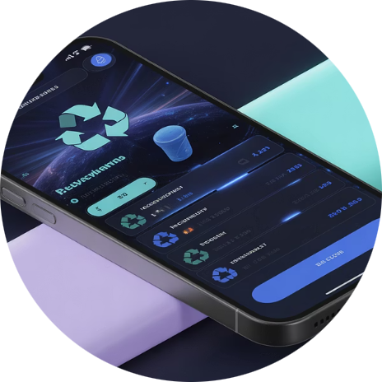
Future Enhancements
WasteWise Smart Card
Direct Cash Rewards
E-Commerce Integration
Gamification Features
Convert accumulated points into real monetary payments for consistent recyclers
Swipe to instantly track and verify recycling credits across any bin location
Redeem credits seamlessly on major online shopping platforms and local retailers
Community challenges, leaderboards, and achievements to boost engagement

Slide 10
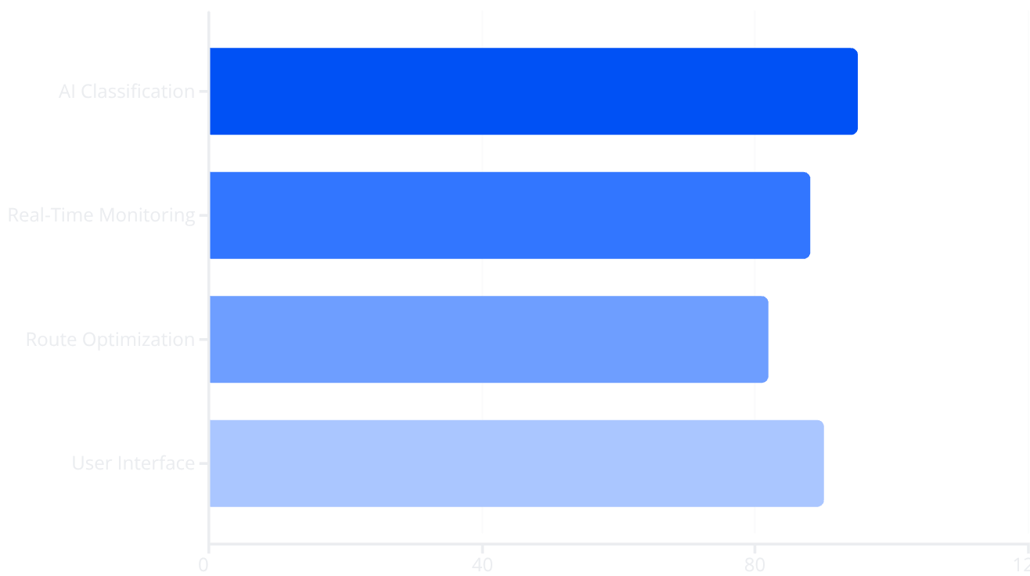
TECHNICAL APPROACH
How WasteWise Works
Robust Tech Stack
Python Core
FastAPI + Uvicorn
Powers entire system architecture
High-performance backend APIs
Local LLM Engine
Knowledge Graph
AI-based waste classification
Lightweight database for known items
Data Analytics
QR Integration
Pandas & Matplotlib visualizations
Bin identification & tracking

Slide 11

A Cleaner, Smarter Future
Ready to Transform
Scalable Solution
Pilot programs available for forward-thinking municipalities
From neighborhoods to entire metropolitan areas
Proven Results
Data-driven ROI and environmental impact metrics
WasteWise: Where technology meets sustainability to create cities that work smarter, not harder

